Slide 1



Corona Virus Analysis with SQL
Shubham Chandarana

Slide 2

Q1. If NULL values are present, update them with zeros for all columns.
In SQL Server, you can use the ISNULL function to replace NULL values with zeros. Here's how you can update all NULL values with zeros for all columns in a table. If you have a column named "Province" in your table and you want to update NULL values in that column with zeros, you can modify the SQL query like this:
UPDATE [POWERBI].[dbo].['Corona Virus Dataset$']
SET Province =0
WHERE Province IS NULL;

Slide 3

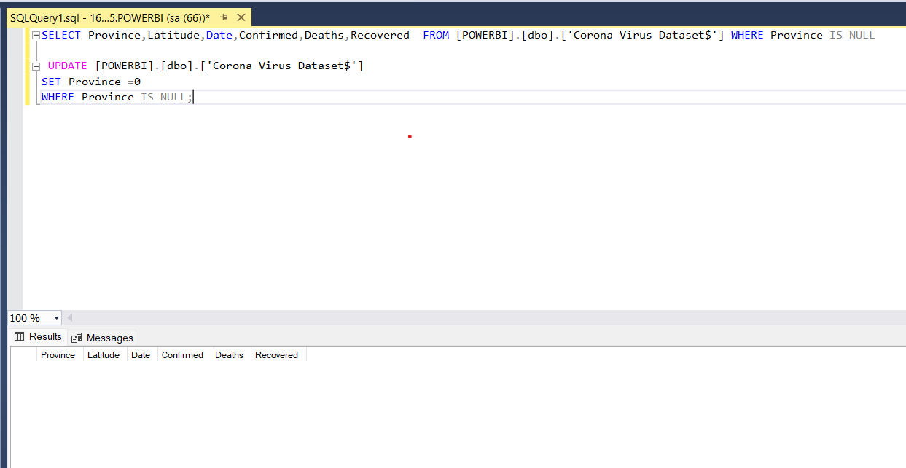
In output we can see there is no null value is present in the table so it is blank

Slide 4

Q2. Find monthly average for confirmed, deaths, recovered To find the monthly average for confirmed, deaths, and recovered cases while formatting the month and year, you can use the FORMAT function in SQL Server. Here's how you can do it: SELECT FORMAT(Date, 'yyyy-MM') AS month, AVG(Confirmed) AS avg_confirmed, AVG(Deaths) AS avg_deaths, AVG(Recovered) AS avg_recovered FROM [POWERBI].[dbo].['Corona Virus Dataset$'] GROUP BY FORMAT(Date, 'yyyy-MM');

Slide 5

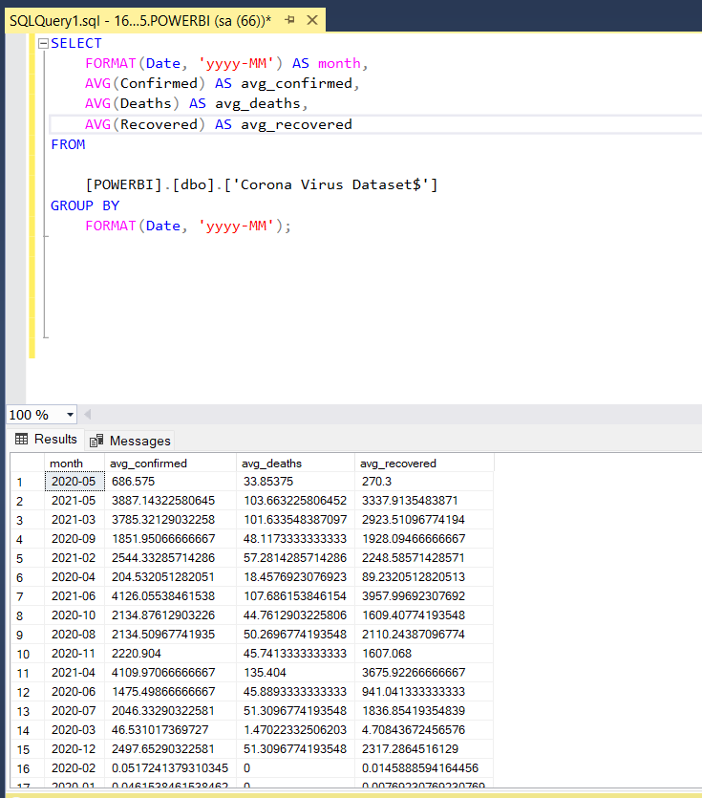
FORMAT(Date, 'MMMM yyyy') formats the Date column as a month-year string, like "January 2024".
GROUP BY FORMAT(Date, 'MMMM yyyy') groups the data by the formatted month-year string.
AVG(Confirmed), AVG(Deaths), and AVG(Recovered) calculate the average for each of these columns.

Slide 6

Q3. Find maximum values of confirmed, deaths, recovered per year
To find the maximum values of confirmed, deaths, and recovered cases per year in SQL, you can use a simple aggregateon query with the MAX() function.
SELECT
YEAR(Date) AS year,
MAX(confirmed) AS max_confirmed,
MAX(deaths) AS max_deaths,
MAX(recovered) AS max_recovered
FROM
['Corona Virus Dataset$']
GROUP BY
YEAR(Date);

Slide 7

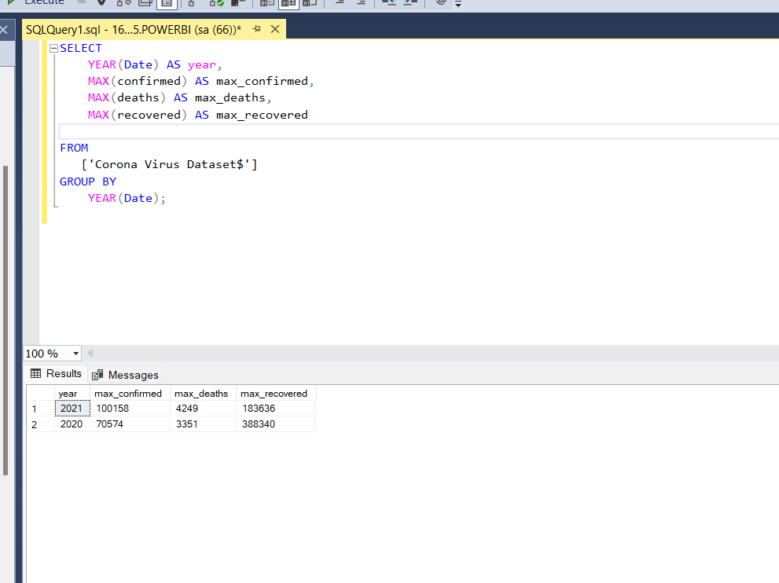
OUTPUT:

Slide 8

Q4 Check how corona virus spread out with respect to confirmed case (Eg: total confirmed cases, their average, variance & STDEV)
we can calculate the total confirmed cases, their average, variance, and standard deviation using aggregate functions and mathematical operations. Since SQL Server doesn't have a built-in VARIANCE function, you can calculate it manually.
SELECT
SUM(Confirmed) AS total_confirmed_cases
FROM
['Corona Virus Dataset$']; SELECT
AVG(Confirmed) AS average_confirmed_cases
FROM
['Corona Virus Dataset$']; SELECT
AVG(CONVERT(FLOAT, confirmed) * CONVERT(FLOAT, confirmed)) - AVG(confirmed) * AVG(confirmed) AS variance_confirmed_cases
FROM
['Corona Virus Dataset$']; SELECT
STDEV(confirmed) AS stdev_confirmed_cases
FROM
['Corona Virus Dataset$'];

Slide 9
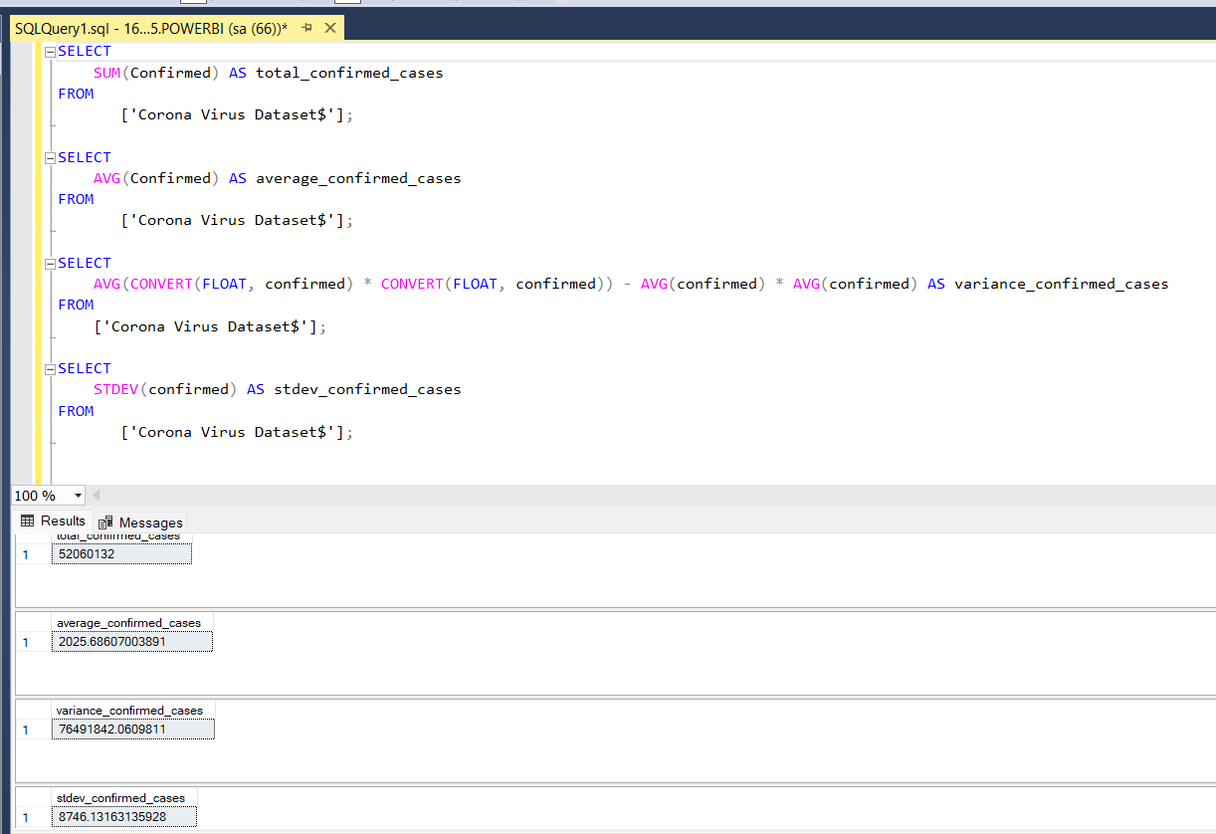
OUTPUT

Slide 10

Q5.Check how corona virus spread out with respect to recovered case (Eg: total confirmed cases, their average, variance & STDEV )
To analyze how the coronavirus spread out with respect to recovered cases, including total confirmed cases, their average, variance, and standard deviation, you can use SQL aggregate functions along with mathematical operations.
SELECT
SUM(recovered) AS total_recovered_cases
FROM
['Corona Virus Dataset$'];
SELECT
AVG(recovered) AS average_recovered_cases
FROM
['Corona Virus Dataset$'];
SELECT
VAR(recovered) AS variance_recovered_cases
FROM
['Corona Virus Dataset$'];
SELECT
STDEV(recovered) AS stdev_recovered_cases
FROM
['Corona Virus Dataset$'];

Slide 11
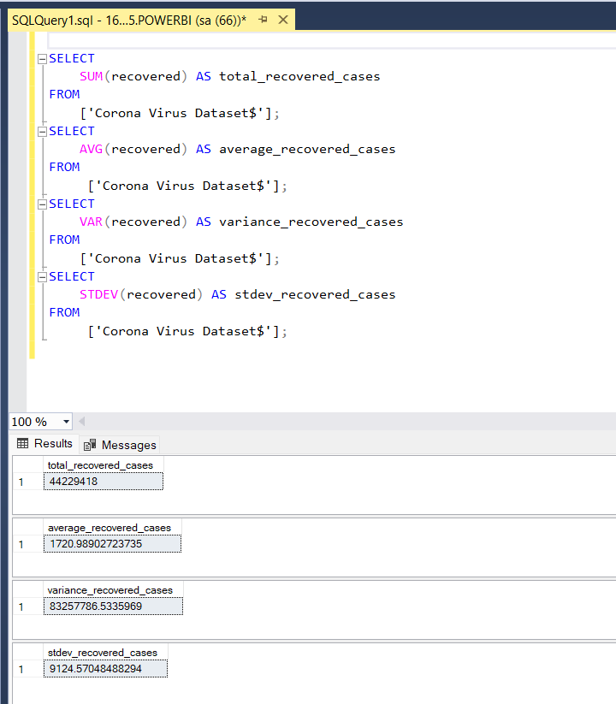
OUTPUT

Slide 12
Q6 .Find top 5 countries having highest recovered case
SELECT [Country/Region], Recovered
FROM (
SELECT
Recovered,
[Country/Region],
ROW_NUMBER() OVER (ORDER BY recovered DESC) AS rank
FROM ['Corona Virus Dataset$']
) AS ranked_countries
WHERE rank <= 5;

Slide 13
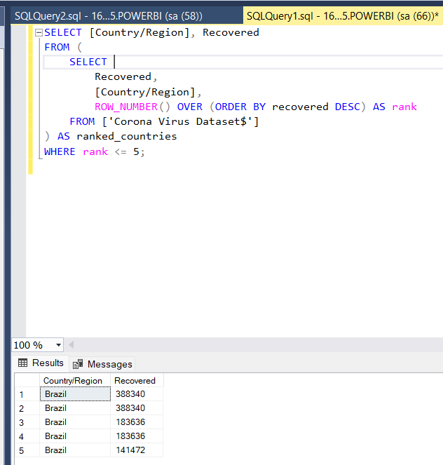
OUTPUT:

Slide 14
THANKS!
Do you have any questions?
Chandaranashubham8128@gmail.com
+91 8128955302

